Slide 1
Protecting your Secrets
When sharing is literally not caring
Notes:
Prior to the talk
Have working “forks” of all of the demo repos:
- https://github.com/blgorman/RescueYourGitRepo
- https://github.com/blgorman/RescueYourGitRepo-RemoveASecret
Going to try to do the live demos without any pre-configuration, just having the repo forked and ready to work with

Slide 2
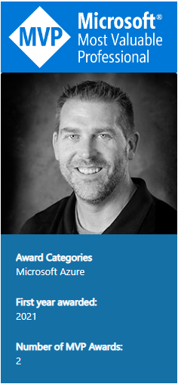
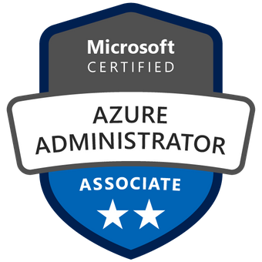
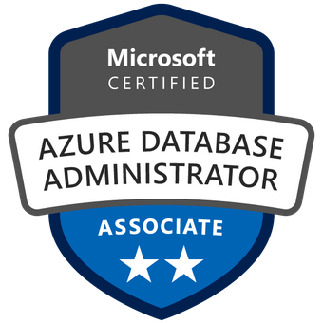
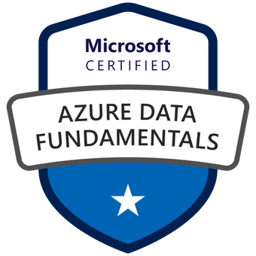
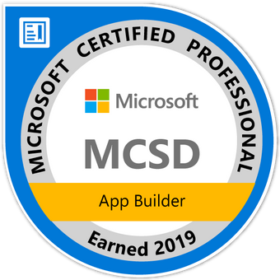
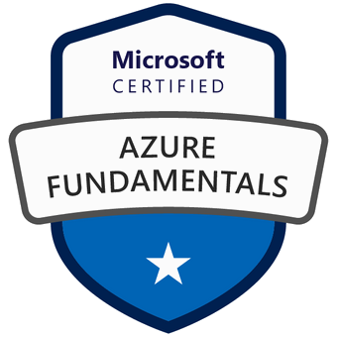
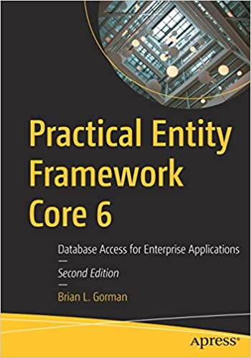
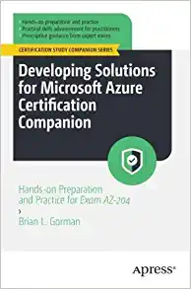
Who am I?
Brian is an experienced speaker, author, trainer, and .Net developer with
MCT (x4) / MVP (x2)/MSLearn Expert MCSD: App Builder Azure Fundamentals Azure Data Fundamentals Azure SCI Fundamentals Azure Administrator Associate Azure Security Associate Azure Developer Associate Azure IOT Developer Specialization Azure Cosmos DB Developer Specialization Azure Database Administrator Associate Azure Solutions Architect Expert Azure DevOps Engineer Expert
Brian has a masters of science degree in computer information systems, and a bachelor of science degree in computer science. Additionally, Brian has over ten years of experience instructing college courses online in SQL databases, C#/VB .Net programming, Java programming, and Microsoft Office.
Brian has also created many online video courses, available on various platforms. Recently, Brian published the second edition of his first book: Practical Entity Framework Core 6 with APress.
Brian runs a company named Major Guidance Solutions, which does contract and custom training and curriculum development. If you are interested in becoming Azure certified, make sure to connect with me.
Connect with Brian on Twitter and/or Linked In
@blgorman
https://www.linkedin/in/brianlgorman
Notes:
My name is Brian, and I’ll be your presenter for today.
I’ve been working in .Net since it was released to beta in 2001, and have been in various web development positions throughout my career, working with all the tech stacks along the way, including ASP.Net 1 and 2 Webforms, MVC, and am now looking into Blazor and Razor pages as .Net is evolving.
In addition to developing web solutions for many different companies, I have also been teaching in the Computer Science department at Franklin University since 2010 and have been developing training courses since about 2013.
I hold a bachelors in CS from Iowa State and an MS in Computer Information Systems from the UoP. I also have a number of Microsoft certifications that I’ve been earning since 2003 and recently published my first book: Practical Entity Framework with APress (with a second edition for .Net5/EFCore5 currently in progress)
Please follow me for updates and communication on twitter or Linked In. Twitter: blgorman
LinkedIn: brianlgorman

Slide 3
Agenda
All the Wrong stuff
Protecting your repos
Move to User Secrets
Leverage Azure Key Vault
Share secrets with Azure App Config
Protecting your logs
Additional Thoughts

Slide 4
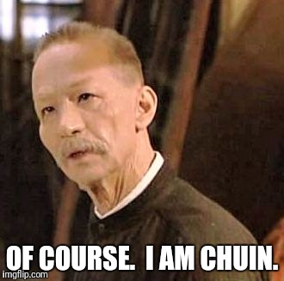
Thank the sponsors and the team
Conferences and Code camps are hard work!
Be excellent to each other
Become a producer and not just a consumer

Slide 5
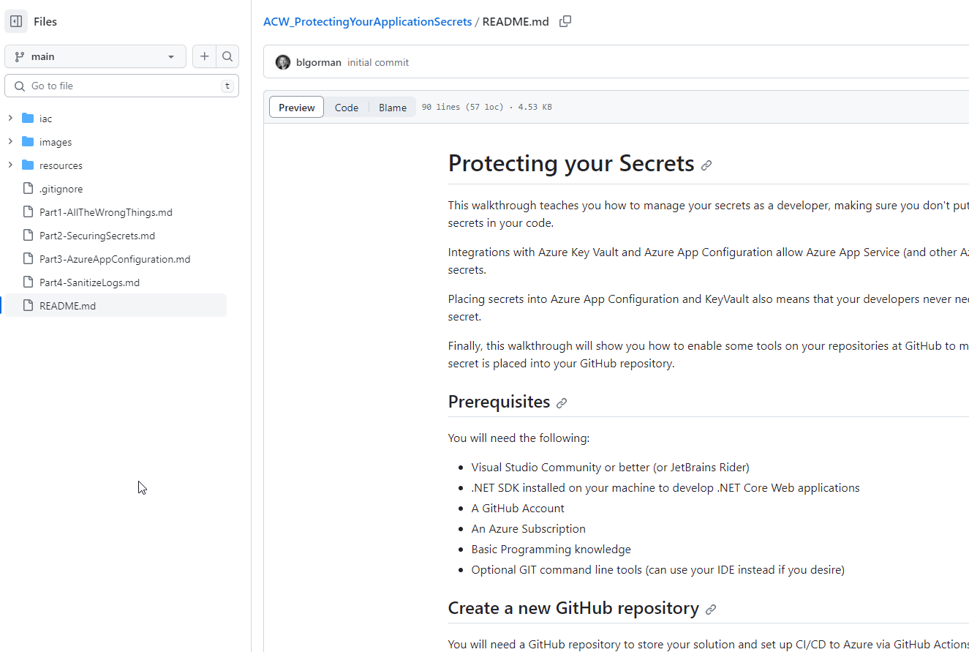
Azure Cloud Workshops [Walkthrough]

Slide 6
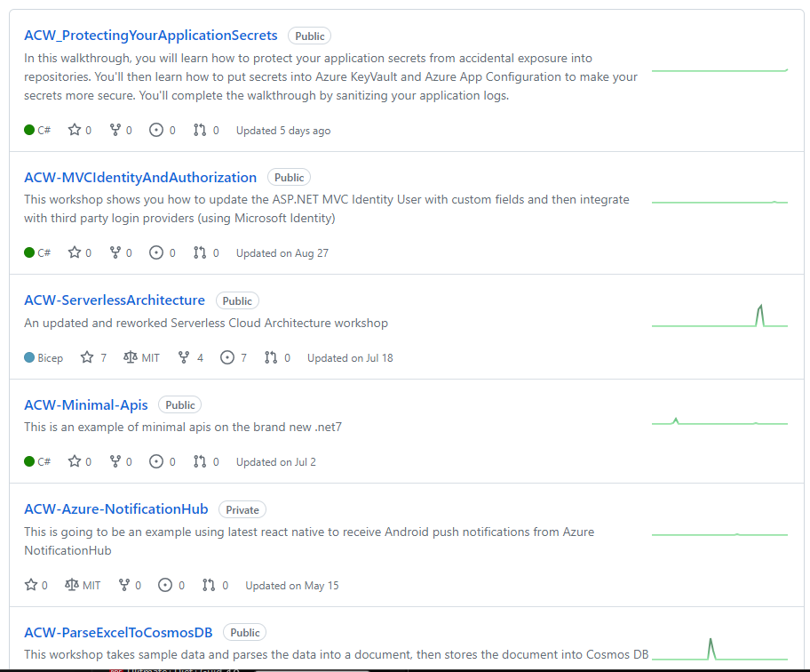
Additional Cloud Workshops

Slide 7
All the wrong Stuff
Nothing is protected, secrets are exposed, any developer can see them

Slide 8
Issues
Secrets are not protected from developers
Secrets are committed to GIT and pushed to repositories
Secret changes require code modification or deployment

Slide 9
Demo
Overview of the solution with all the wrong things

Slide 10
Notes:
Code from the starter project – deployed via an action at GitHub – repo
Azure App Service
Azure SQL Server
Tries to register
Updates from local – Server Firewall…
Sets connection string into the appsettings.json
Secrets are in the appsettings.json file
- App Insights Connection String
- Database Connection at Azure
- Storage Account SAS
For now, don’t worry about the KeyVault and App Configuration

Slide 11
Protecting Your Repos

Slide 12
Keep your secrets out of the Repo
Use Code Scanning/Alerting
Use Security Tools at GitHub
Use GitGuardian (or something similar)
Move code to secrets.json (Manage User Secrets)
Add configuration values on the App Service (can be per environment)

Slide 13
Demo
Review GitGuardian Alerts and Move secrets out of the appsettings.json

Slide 14
Notes:
Code from the starter project – deployed via an action at GitHub – repo
Azure App Service
Azure SQL Server
Tries to register
Updates from local – Server Firewall…
Sets connection string into the appsettings.json
Secrets are in the appsettings.json file
- App Insights Connection String
- Database Connection at Azure
- Storage Account SAS
For now, don’t worry about the KeyVault and App Configuration

Slide 15
Utilize Key Vault
Move secrets to Azure Key Vault

Slide 16
Benefits of Key Vault
Managed by Administrators
Developers and others never need to know secrets
Automated Rotation of secrets is possible
Stores Keys, Secrets, and Certificates
Easily integrates with PaaS offerings and application code

Slide 17
Demo
Move the secrets to Azure Key Vault

Slide 18
Notes:
Code from the starter project – deployed via an action at GitHub – repo
Azure App Service
Azure SQL Server
Tries to register
Updates from local – Server Firewall…
Sets connection string into the appsettings.json
Secrets are in the appsettings.json file
- App Insights Connection String
- Database Connection at Azure
- Storage Account SAS
For now, don’t worry about the KeyVault and App Configuration

Slide 19
Utilize Azure App Config
Move secrets to Azure Key Vault

Slide 20
Benefits of App Configuration
Managed by Administrators
Integrates easily with KeyVault
Easily share secrets amongst applications
Can be utilized as a common developer secret store (dev subscription)

Slide 21
Demo
Move the secrets to Azure App Configuration

Slide 22
Notes:
Code from the starter project – deployed via an action at GitHub – repo
Azure App Service
Azure SQL Server
Tries to register
Updates from local – Server Firewall…
Sets connection string into the appsettings.json
Secrets are in the appsettings.json file
- App Insights Connection String
- Database Connection at Azure
- Storage Account SAS
For now, don’t worry about the KeyVault and App Configuration

Slide 23
Sanitize your logs
Move secrets to Azure Key Vault

Slide 24
What are you logging?
Make sure you don’t log PII
Make sure you don’t accidentally log a secret value
Make sure your logs are useful

Slide 25
Demo Time
Sanitize your log with a TelemetryInitializer

Slide 26
Other Considerations
Where else might you have secrets hiding?

Slide 27
Other concerns
Backups
User Hard Drives/Sticky Notes
LastPass/Bitwarden/PassPack
Legacy Code

Slide 28
Summary
As a developer, you MUST care about protecting your secrets
Protect at every level, not just Production
Secrets go in a vault, vaults should be scoped, and access should be managed well
Any secret in the repository is compromised
Keep the secrets out of your logs
Be wary of third-party plugins

Slide 29
Questions?
Email:
brian@majorguidancesolutions.com
blgorman@gmail.com
Twitter
@blgorman
Linked In
https://www.linkedin/in/brianlgorman
Code:
https://github.com/AzureCloudWorkshops/ACW_ProtectingYourApplicationSecrets
Join an MS Learn Room:
https://techcommunity.microsoft.com/t5/custom/page/page-id/learn

Slide 30
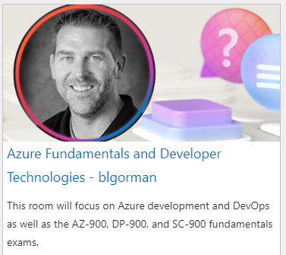
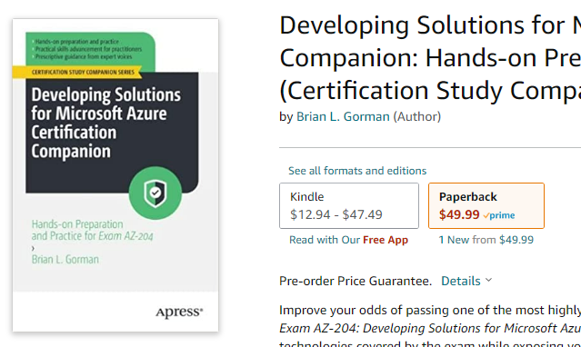
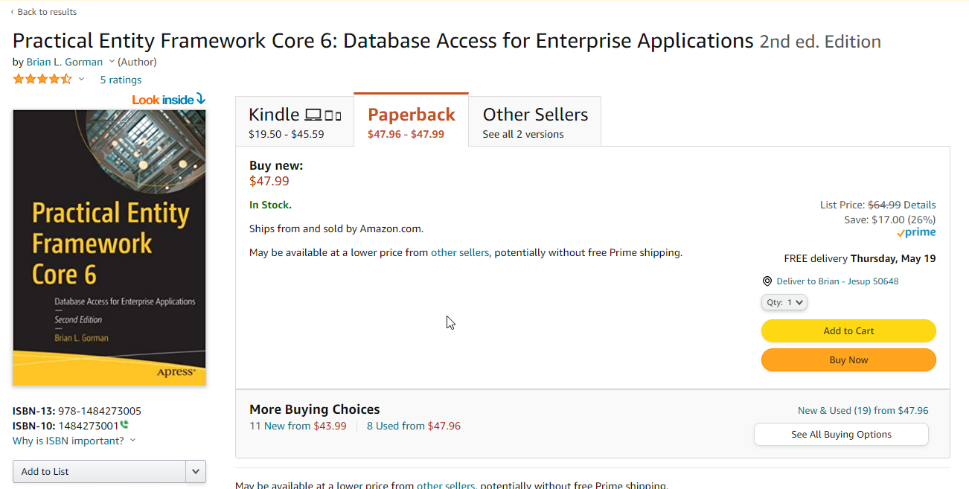
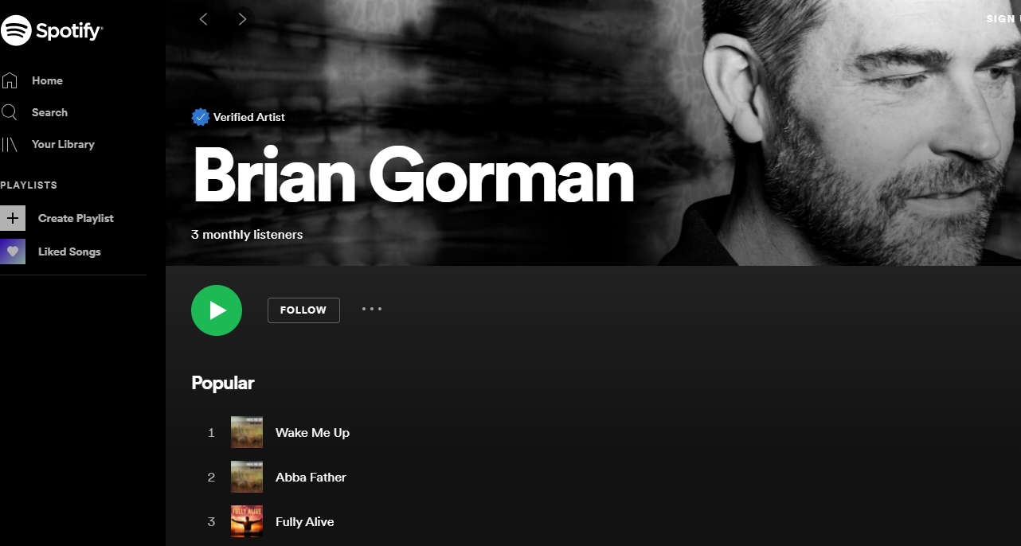
Conclusion
https://github.com/AzureCloudWorkshops/ACW_ProtectingYourApplicationSecrets
@blgorman
https://www.linkedin.com/in/brianlgorman
Thanks for having me today!
Notes:
Thank you for attending my talk today. Please reach out and connect.
If you liked the talk today, you can support me by listening to one or more of my songs on spotify ☺ https://open.spotify.com/artist/0rRlrvBVhAhZCHcENoiFJ0
Look for one of my books on Amazon
https://www.amazon.com/stores/author/B08MQBWN49/allbooks?ingress=0&visitId=aceaf328-e862-4292-ad9b-ff622549f2f1&store_ref=ap_rdr&ref_=ap_rdr
And/or join a learning room (mine or others)
https://techcommunity.microsoft.com/t5/custom/page/page-id/learn?fbclid=IwAR0Mq6MMG5xt31RYWdJgqsq2078qFmjQggze08GaQ3Rm9sV4qC9ARjC7ElA
https://github.com/AzureCloudWorkshops/ACW_ProtectingYourApplicationSecrets

